Slide 1
Algorithms and Data Structures (CIS1002-N)
Week 5: Linked-Lists and Ordered Linked-Lists
Module Leader: Dr Annalisa Occhipinti
Email: A.Occhipinti@tees.ac.uk

Slide 2
Schedule
Week | Lecture (1hour) – Lab Session (2hours)
Week 1 | Introduction to Algorithms and related Data-Structures – Array ADT
Week 2 | Sorting : Bubble sort, Cocktail Shaker sort | ICA Briefing
Week 3 | Sorting : Selection sort and Insertion sort
Week 4 | Singular Linked-lists | ICA Briefing – Programming Tasks
Week 5 | Circular Linked Lists and Ordered Linked Lists
Week 6 | Doubly Linked-lists
Week 7 | Stacks
Week 8 | Queues
Week 9 | Recursion
Week 10 | Recursion
Week 11 | Trees and balanced trees
Week 12 | Merge Sort and Quick Sort
Note: The schedule may be adjusted based on class progress.

Slide 3

Last week’s quiz
Well done to:

Slide 4
Homework: Interview Question*:
Write a function to swap two numbers in an array without a temporary variable.
Hint: make use of your maths skills!

Slide 5
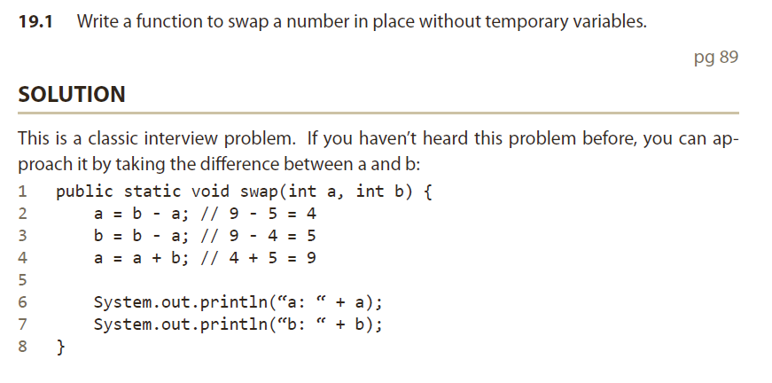

Slide 6
Today…
Circular Linked Lists
Ordered Linked-lists

Slide 7
Linked-Lists (recap)
Definition:
Collection of components, called nodes.
Each node in a linked-list has 2 components:
1 to store the relevant information: data
1 to store the address of the next node: next
Each node (except the last node) contains the address of the next node.
head
data
next
data
next
data
next
data
next
data
null

Slide 8
ICA Checkpoint: Which one is the node at index 1?
0
1
2
3
4
Both of them are valid, make sure you read the requirements before writing a new method.
head
data
next
data
next
data
next
data
next
data
null
1
2
3
4
5
head
data
next
data
next
data
next
data
next
data
null
In this week’s lab:
1-index based system
In the ICA, programming tasks:
0-index based system
In lesson:
Both 0-index and 1-index based systems

Slide 9
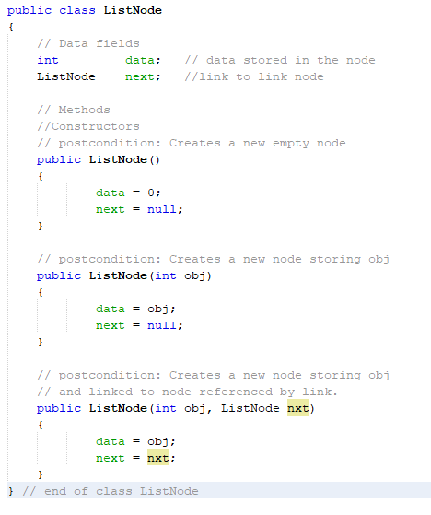
First step: creating the ListNode class

Slide 10
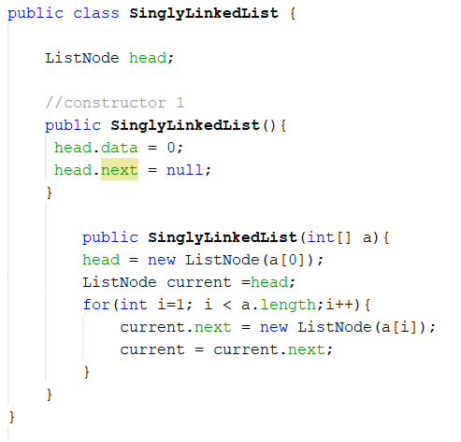
Second Step: LinkedList class (left to right)

Slide 11
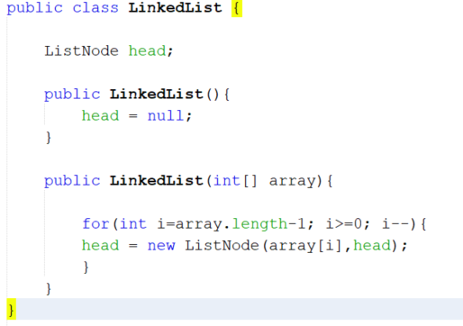
Second Step: LinkedList class (a more elegant solution…)

Slide 12
Recap Question…
Implement the method below for the LinkedList class
int getLast(): return the data value of the last item
You could start by drawing a diagram.

Slide 13
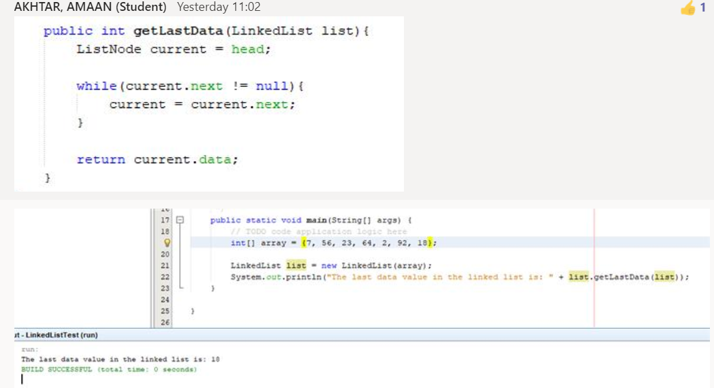
Recap Question…
Implement the method below for the LinkedList class
int getLast(): return the data value of the last item
You could start by drawing a diagram.

Slide 14
Circular Linked Lists

Slide 15
Variations of Linked-Lists
Circular linked-lists with dummy node
The last node points to the dummy node
How do we know when we have finished traversing the list?
(Tip: check if the pointer of the current node is equal to the head, i.e. the dummy node.)
Dummy-node
X
A
B
C
Head

Slide 16
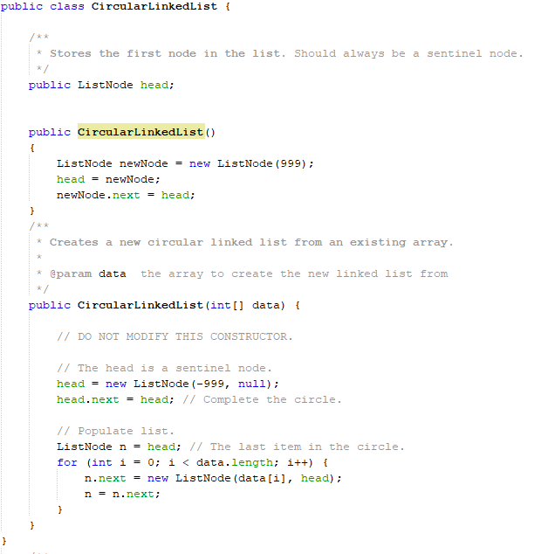
Implementation

Slide 17
Properties
To search a circular linked-list:
begin at any node and follow the list until you return to the original node.
Can be seen as having neither beginning, nor end.
Head-node is logical successor of the tail node
Useful for:
naturally circular structures (e.g. days in week; months in year, to simulate a conveyor belt, etc…)
Can traverse the list starting at any point.

Slide 18
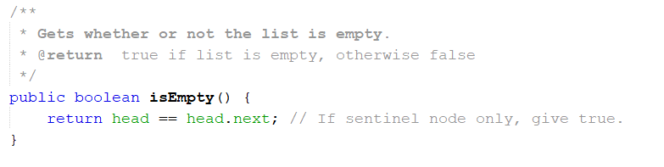
What’s different from Singly-Linked Lists?
Boolean isEmpty()
String toString()
int getLast() – 999 if empty.
void addLast(int value)
Void addFirst(int value)
current!=null
Will become…
current!= head

Slide 19
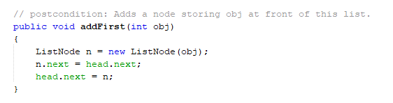
Inserting a node at the beginning of the list

Slide 20
Let’s add some methods!
int getFirst() – retrieve the data stored in the first node of the list, if it exists. Return 999 if the list is empty.
int getSize() – return the size of the linked list
void addLast(int value) – add a node at the end of the list (empty list?)
int getLast() – retrieve data in the last node of the linked list, if it exists. Return 999 if the list is empty.
String toString() – return a description of the content of the linked list. If the list is a = {1, 4, 0, 6, 3}, the returned string should be in the format “1\n4\n0\n6\n3\n” - \n means “new line”. Return an empty string “” if the list is empty.

Slide 21
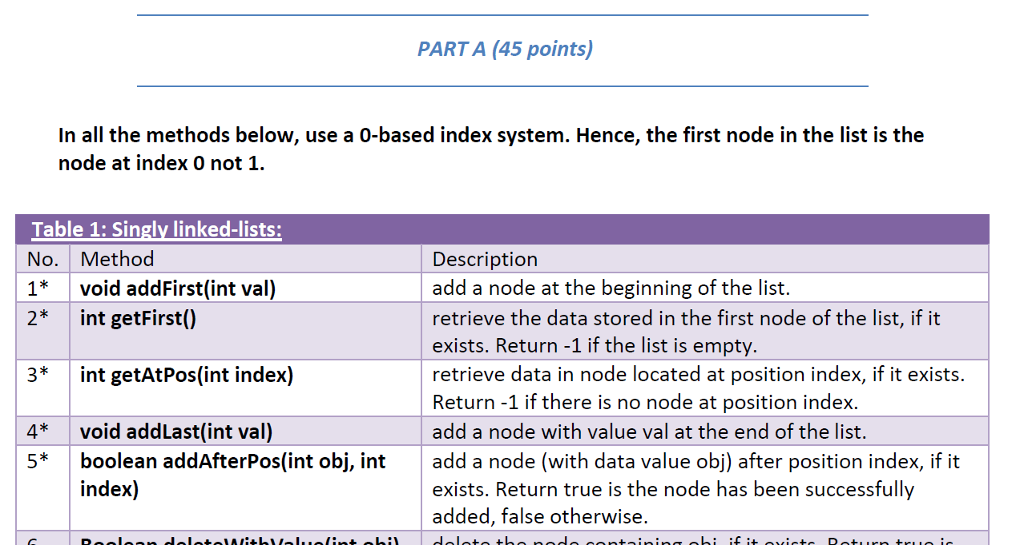
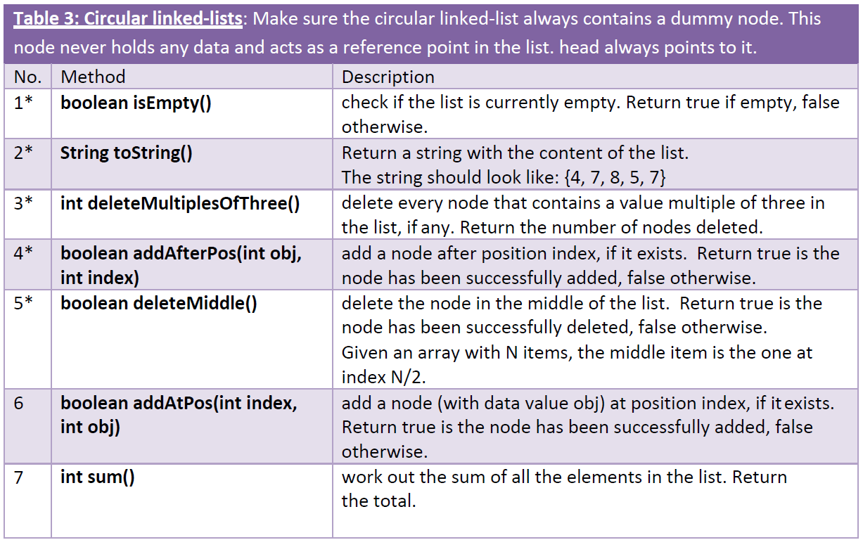
Version 3 of the ICA makes this clearer
Download the new version from BB

Slide 22
More Methods
void addFirst(int value) – add a node at the beginning of the list
int getAtPos(int index) – retrieve data in node located at position index (in a 1-index based system), if it exists. Return 999 if the node does not exist.
3* boolean delete(int n) – delete the n^{th} node in the list (in a 1-index based system). Return true if the node is deleted, Return false if the n^{th} node does not exist – what if n == 1?.
What if the list is empty?

Slide 23
Quizzis

Slide 24

And some more…
boolean addAfterPos(int obj, int index) – add a node after position index (in a 1-based index), if it exists. Return true is the new node has been added successfully. Return false if the node at position index does not exist.
ListNode searchPointer(int n) - return a pointer to node containing n, or null if not found.
int searchIndex(int n) - return a one-based index to node containing n, or
-1 if not found
What if the list is empty?

Slide 25
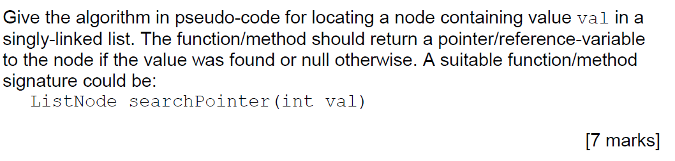
Interview Question. Search for a value
You should assume that the list is not ordered.

Slide 26
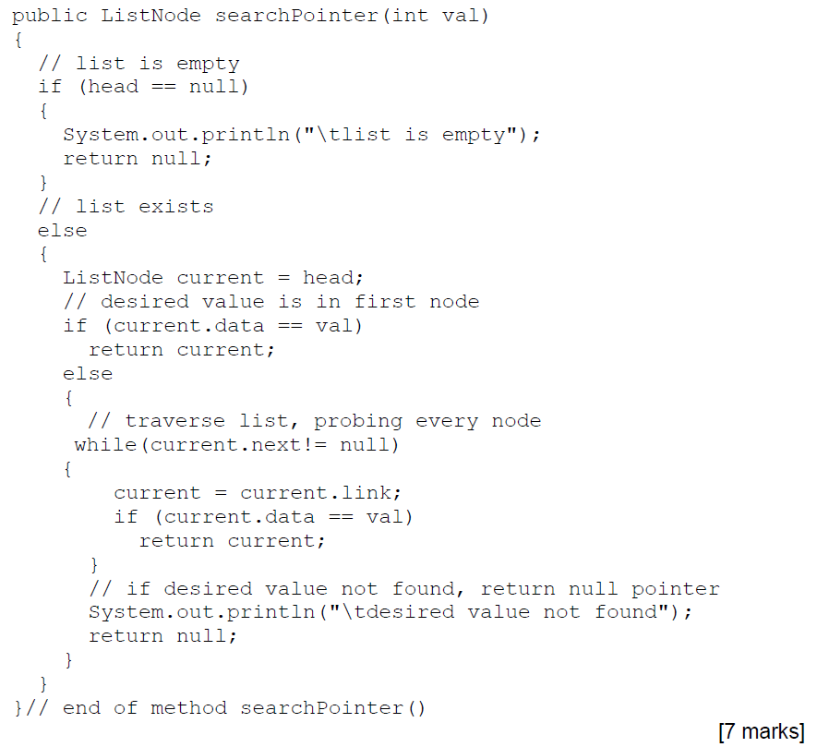
This is just one possible answer.
Make sure you add comments in your code.

Slide 27
Homework:
Inserting a node in an ordered linked list.
public void insert(int entry)
To insert an item:
Find the place where the new item is supposed to go,
Insert the item in the list.
3 Cases to consider:
Case 1: the list is initially empty.
Case 2: the new item is smaller than the smallest item in the list.
Case 3: the item is to be inserted within the list.

Slide 28
Inserting – cases to consider
To insert an item:
Find the place where the new item is supposed to go,
Insert the item in the list.
Case 1: the list is initially empty.
Case 2: the new item is smaller than the smallest item in the list.
Case 3: the item is to be inserted within the list.

Slide 29
Oredered Lists. Deleting – cases to consider
To delete a given item:
Search the list to see if the item exists,
Delete the item
Case 1: the list is initially empty.
Case 2: the item to be deleted is contained in the first node of the list.
Case 3: the item to be deleted is somewhere in the list.
Case 4: the list is not empty, but the item to be deleted is not in the list.

Slide 30
Supplementary Material
Recap of basic methods in linked lists.

Slide 31
Traversing - Algorithm
current = head;
while (current != null)
{
print(current.data + “ “);
current = current.next;
}
head
1500
1532
1564
1596
1628
1500
12
1532
54
1564
3
1596
67
1628
32
1500
current
1532
current
1564
current
1596
current
1628
current
Output to console ?
12 54 3 67 32

Slide 32
Insertion (1)
1500
1532
1564
1596
1628
1500
12
1532
54
1564
3
1596
67
1628
32
head
current
Insert a new node after node pointed at by current

Slide 33
Insertion (2)
1500
1532
1564
1596
1628
1500
12
1532
54
1564
3
1596
67
1628
32
head
current
Create new node (with data value):
newNode
1800
1800
12

Slide 34
Insertion (3)
1500
1532
1564
1596
1628
1500
12
1532
54
1564
3
1596
67
1628
32
head
current
newNode
1800
1800
12
1532
newNode should point at next element after current.

Slide 35
Insertion (4)
1500
1532
1564
1596
1628
1500
12
1800
54
1564
3
1596
67
1628
32
head
head
current
newNode
newNode
1800
1800
12
12
1532
1800
1532
1800
Current node link changed to point at newNode

Slide 36
Insertion – Final result
head
1500
1532
1564
1596
1628
1500
12
1800
54
1564
3
1596
67
1628
32
1800
12
1532
Done!!!

Slide 37
Insertion - Algorithm
newNode
1800
Create
newNode = new ListNode();
Point to next
newNode.next = current.next;
Link to previous
current.next = newNode;
1800
12
newNode
1800
1800
12
1532
1800
12
1532

Slide 38
Warning – Order is crucial
newNode = new ListNode();
current.next = newNode;
newNode.next = current.next;
newNode
1800
1800
12
newNode
1800
1800
12
1800
12
1800

Slide 39
Deletion – Algorithm (1)
toDelete = current.link;
current.link = toDelete.Link;
toDelete.link = null;
toDelete = null;
1532
1532
1564
1564
1596
1500
1596
1628
1500
12
1532
54
1564
3
1596
67
1628
32
current
toDelete

Slide 40
Deletion (2)
1532
1532
1564
1564
1596
1500
1596
1628
1500
12
1532
54
1564
3
1596
67
1628
32
current
toDelete

Slide 41
Deletion (3)
1532
1532
1564
1596
1500
1564
1596
1628
1500
12
1532
54
1596
3
67
1628
32
current
toDelete
Unlink the marked node by making it link to null.
Set toDelete to null.
The Garbage Collector will return the isolated node to the system.

Slide 42
Deletion – Final result
head
1500
1532
1596
1628
1500
12
1532
54
1596
67
1628
32

Slide 43
Array versus Linked-Lists
Linked-lists are more complex to code and manage than arrays, but they have some distinct advantages.
Dynamic: a linked-list can easily grow and shrink in size.
We don’t need to know how many nodes will be in the list. They are created in memory as needed.
In contrast, the size of an array is fixed at either compilation or run-time.

Slide 44
Array versus Linked-Lists
Linked-lists are more complex to code and manage than arrays, but they have some distinct advantages.
Easy and fast insertions and deletions
To insert an element in an array, we need to shift variables to the right to make room for new element.
To delete an element in an array, we need to close the gap caused by the deleted element, by shifting all variables to the right of the gap by one to the left.
With a linked-list, no need to move other nodes.
We only need to reset some links
(reference-variables / pointers).

